Slide 1
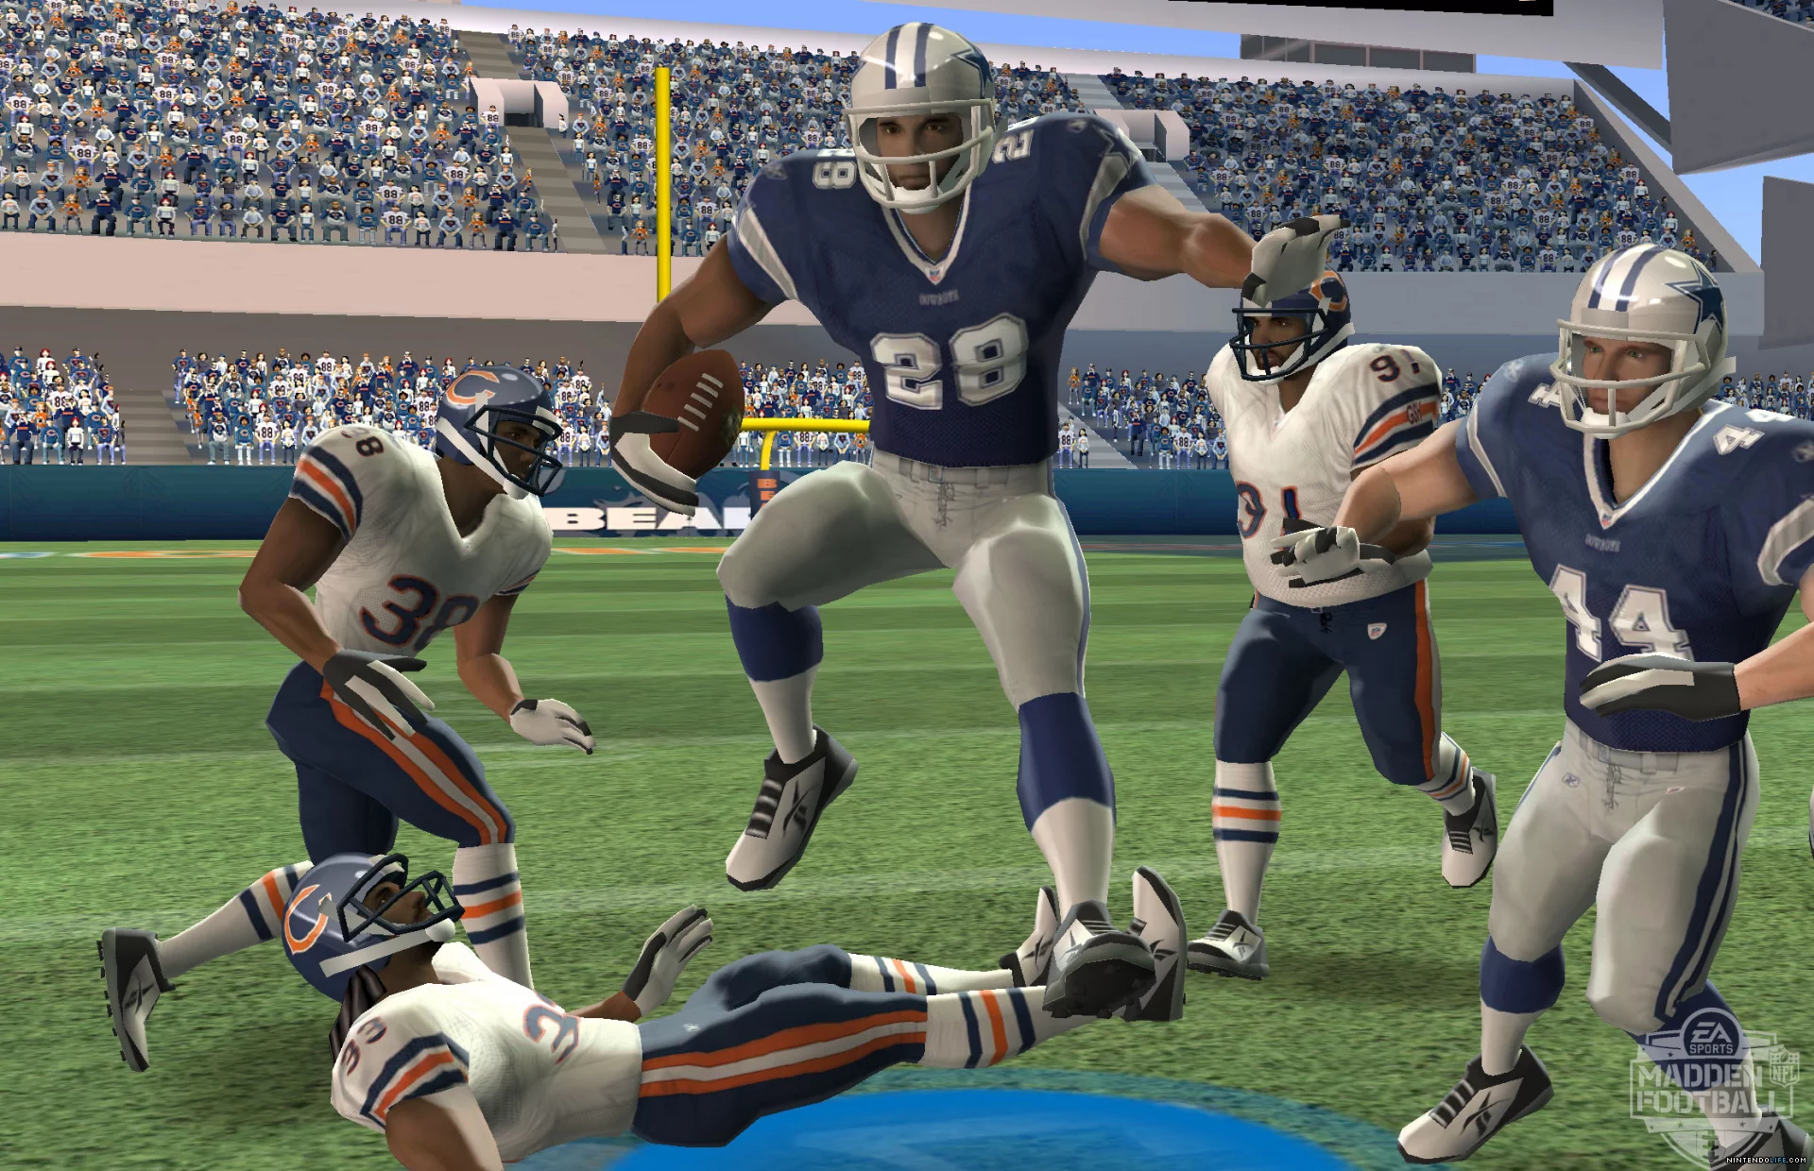
NFL Big Data Bowl
Barger
Hershey
Moore
Prihar

Slide 2
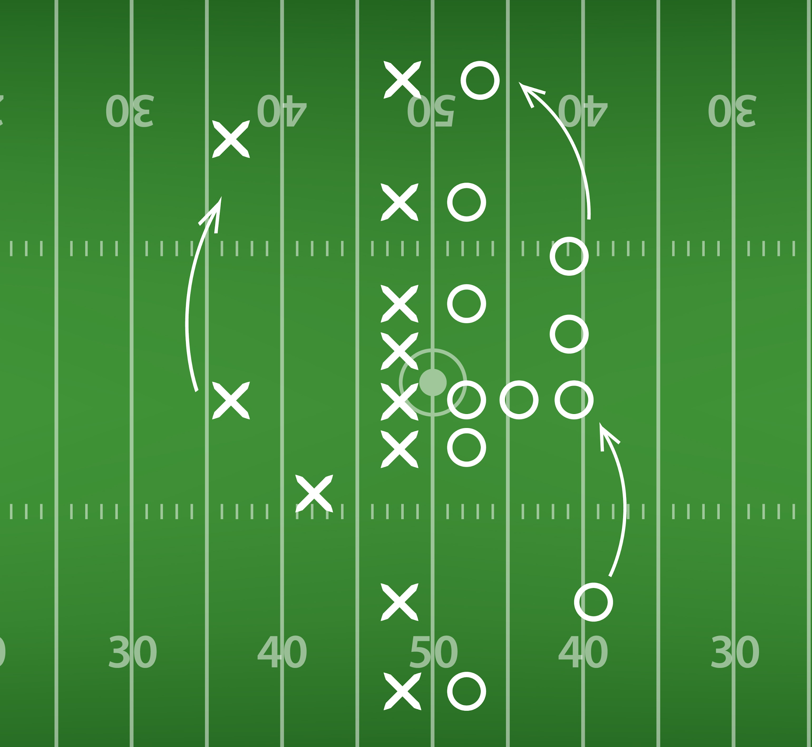
Kaggle Competition to predict yardage of plays
Training data of 23,000 running plays
across 49 features
https://2s7gjr373w3x22jf92z99mgm5w-wpengine.netdna-ssl.com/wp-content/uploads/2019/02/football_play_shutterstock_inspired-fiona.jpg

Slide 3
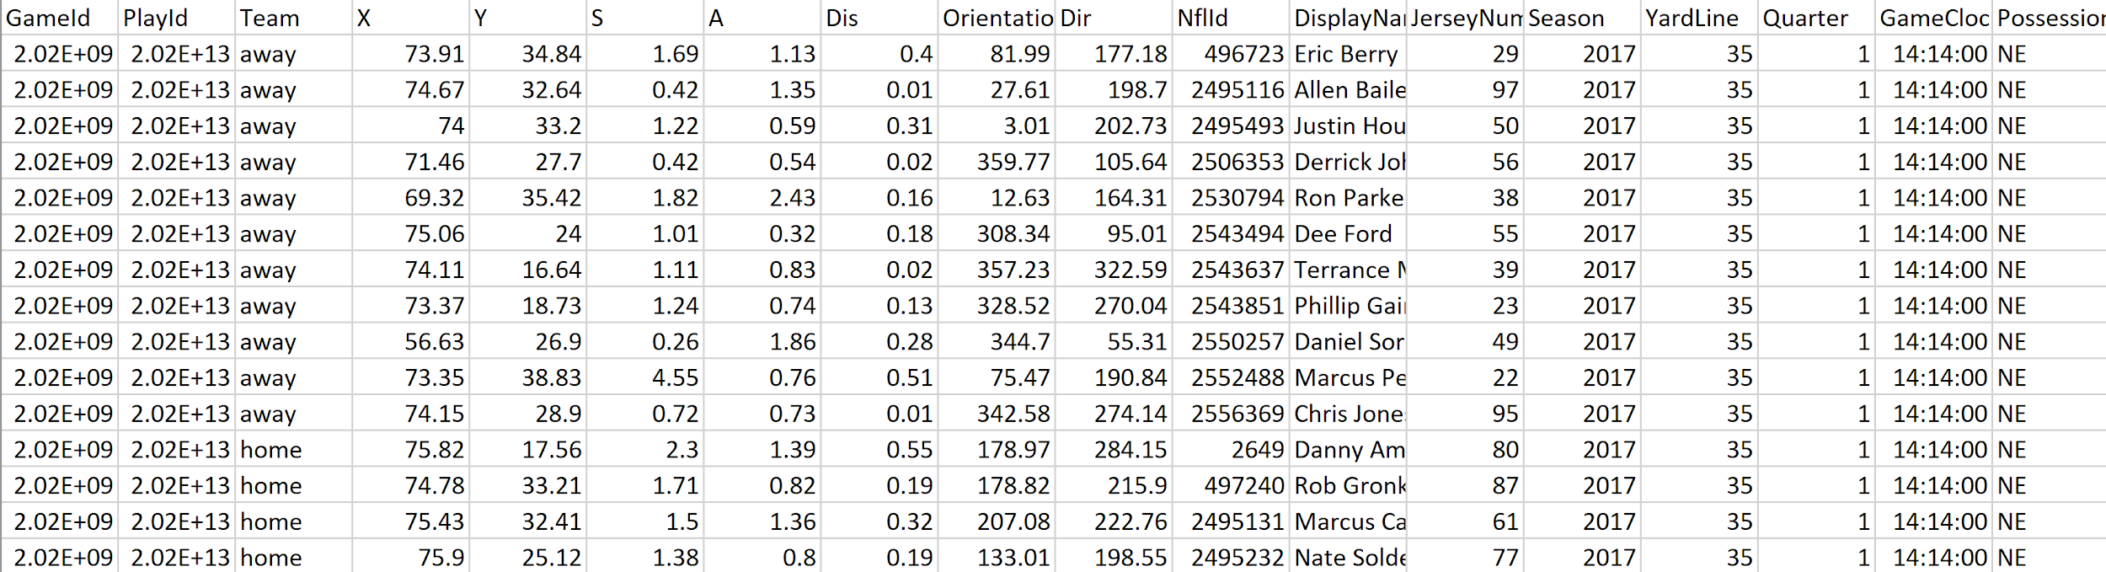
Data Problems
Single features independent to target, Complex Plays

Slide 4
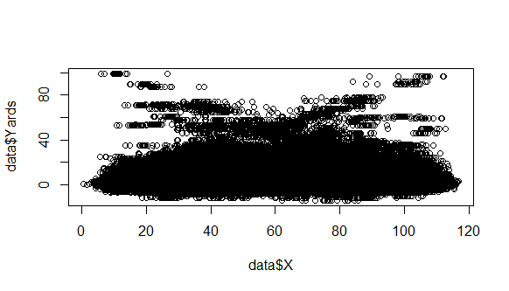

Slide 5
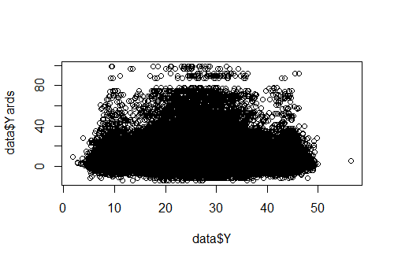

Slide 6
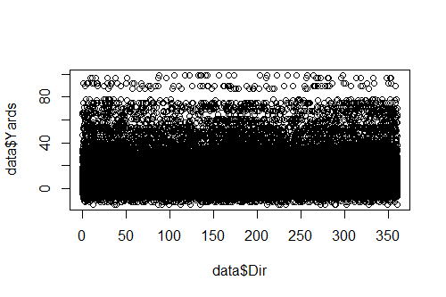

Slide 7
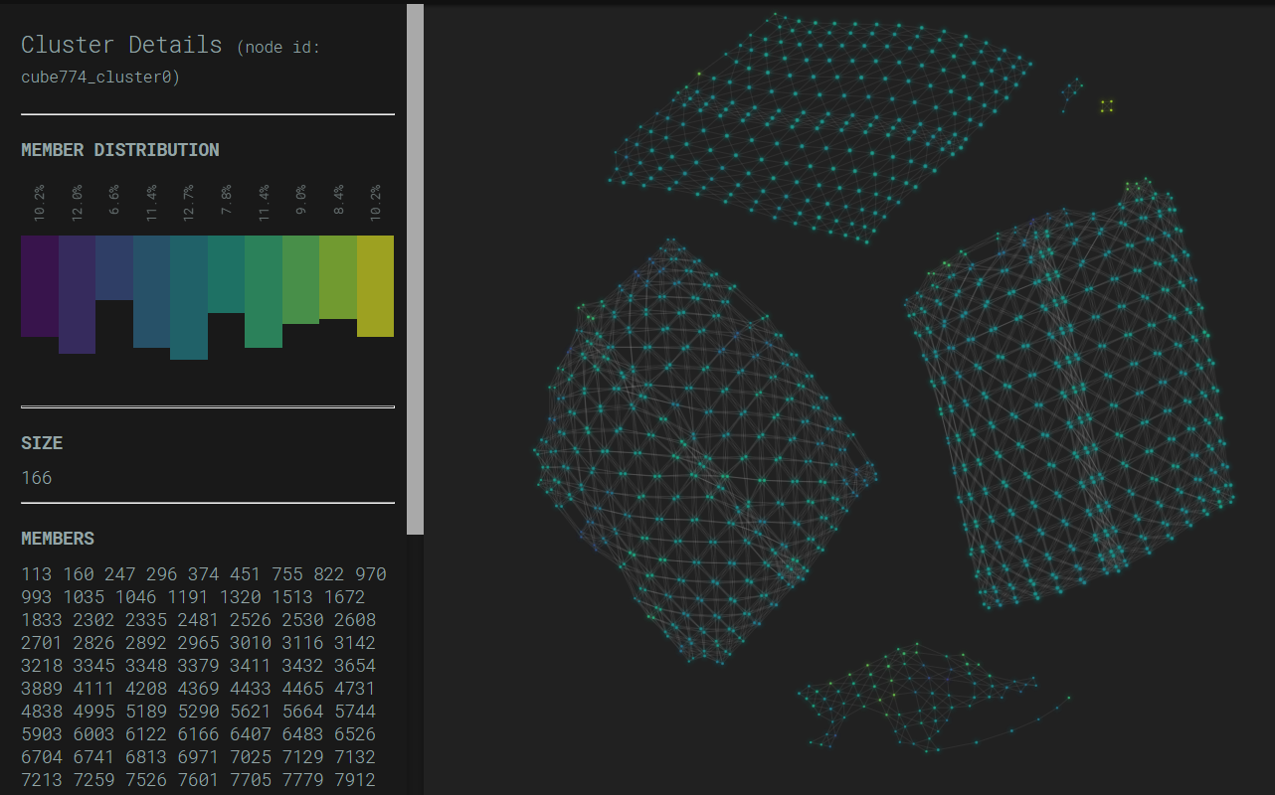

Slide 8
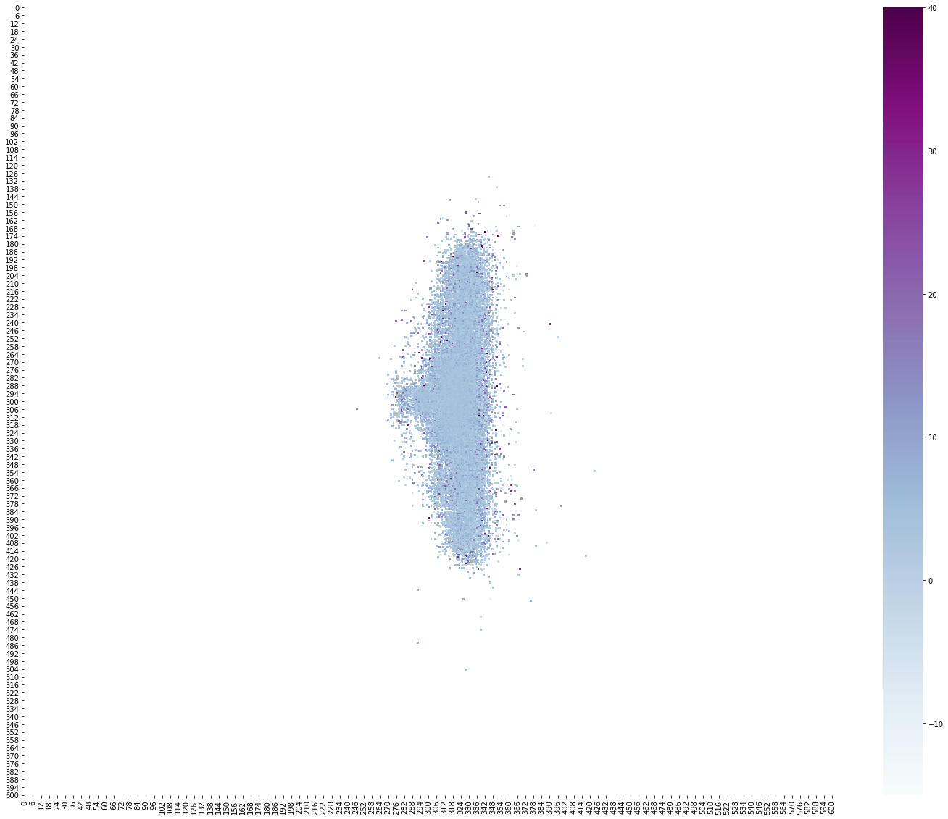
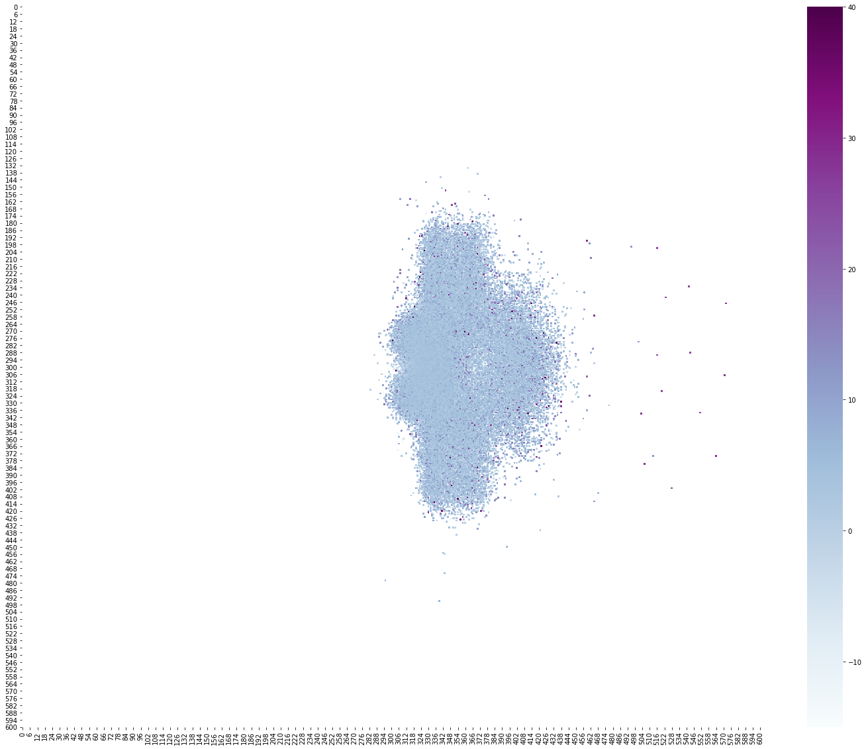
Offense Position
Defense Position

Slide 9
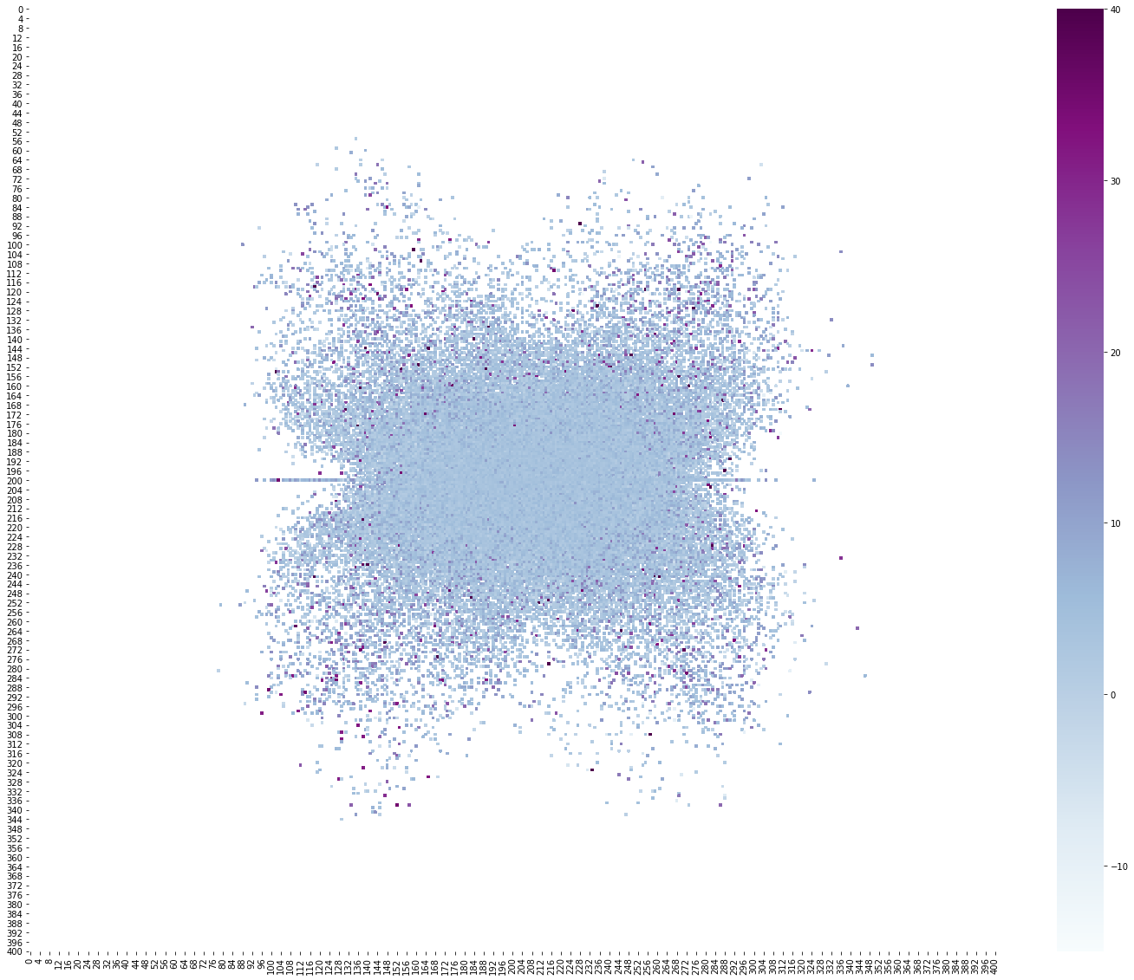
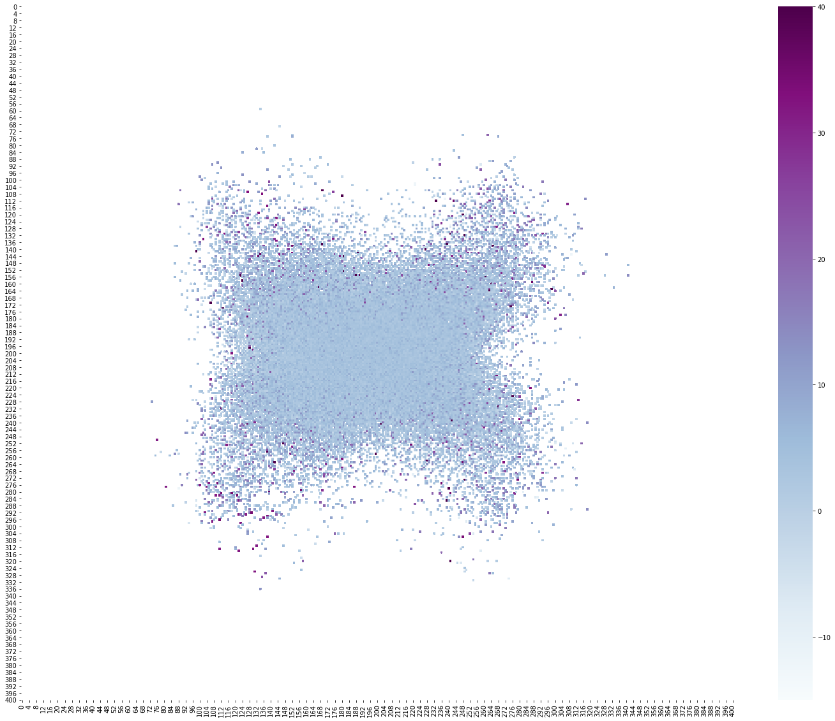
Offense Velocity
Defense Velocity

Slide 10
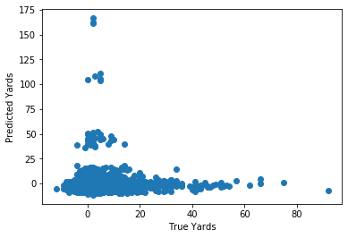
Model Comparison
Model: | Average Value | Linear Regression | Regression Tree | Neural Network
MSE: | 38.01 | 37.24 | 38.73 | 47.88

Slide 11
What features were important to the linear regression model?
Offensive Formation
Defensive Backers

Slide 12
Conclusions
Linear Regression Slightly Improved from the zero-r model.
Next Steps:
Robust Feature Extraction
Physics Model

